Slide 2
Call for Papers
DEADLINE:
30 November 2021
Speaker Focus Areas
Determination of roads needs and financing mechanisms.
Preserving Africa's road assets.
Safe and efficient transport by road.
Innovative practices to optimise road networks.
Roads and the environment.
The role of low volume roads in rural connectivity.
Capacity development in the roads sector.
Any other suitable papers that may not fit into the above sub-themes.

Slide 3
Call for Papers
DEADLINE:
30 November 2021
Important Dates
30 November 2021
Call for Papers Deadline
31 January 2022
Notification of Acceptance
31 July 2022
Formal Paper Submission Deadline
25 – 27 October 2022
Conference
Important Information
Presentation time is 20 minutes + 10 minutes for introductions and questions.
Papers should be submitted in English online at sbs.co.za/sarf2022

Slide 4
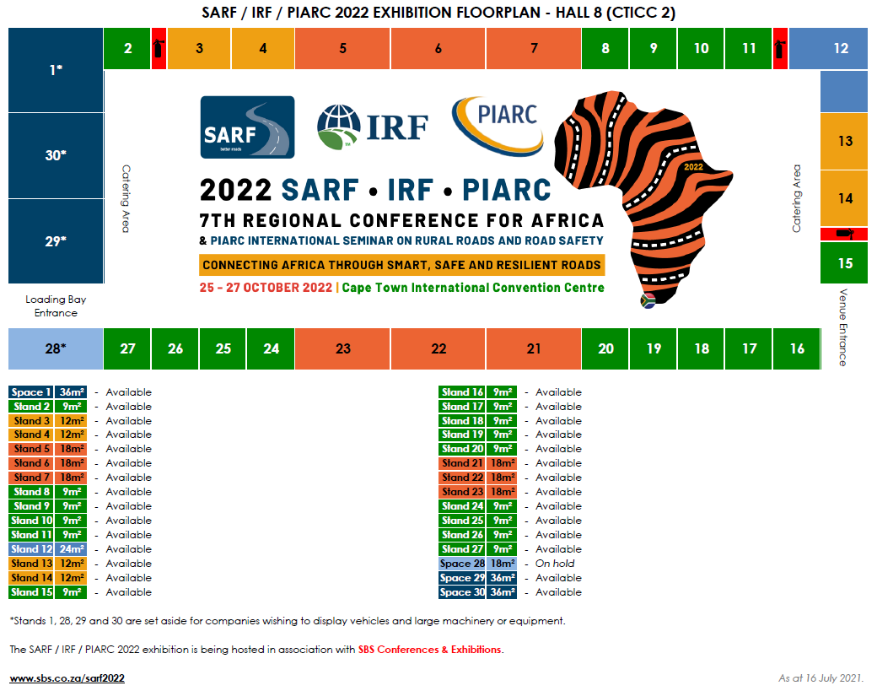
Call for Exhibitors
Exhibition Options
Stands range from 9m² - 24m².
Space only stands (for vehicles or large equipment/machinery) range from 24m² - 36m².
Costs
Stand packages: R2 800 per square metre + VAT.
Space only stand packages: R2 400 per square metre + VAT.

Slide 5
Call for Sponsors
Sponsorship Options
GOLD
R100 000
+ VAT
SILVER
R75 000
+ VAT
BRONZE
R50 000
+ VAT
GOLD + PLENARY VENUE
R200 000 + VAT
GOLD + GALA DINNER
R200 000 + VAT
GOLD + WELCOME COCKTAIL PARTY
R160 000 + VAT
LUNCHES
(3 days available)
R75 000 + VAT
BRANDED CONFERENCE BAGS
R60 000 + VAT
CONFERENCE PROGRAMME
R60 000 + VAT
MOBILE APPLICATION
R60 000 + VAT
ONE-PAGE ADVERT IN PROGRAMME
R15 000 + VAT

Slide 6
More Information
The 2022 SARF / IRF / PIARC 7th Regional Conference for Africa & PIARC International Seminar on Rural Roads and Road Safety is being presented in association with SBS Conferences & Exhibitions.
Website: sbs.co.za/sarf2022
Email: info@sbs.co.za
Telephone: 071 348 1780

