Slide 1
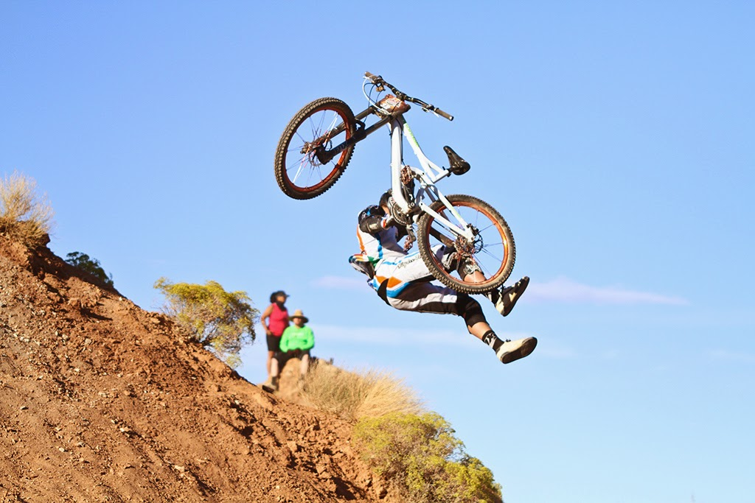

Workshop:
Challenges faced & lessons learnt 1st phase of N3 & N2 :
Aggregate suppliers
Presented on behalf of
Jeremy Hunter-Smith (IQSA, blurock quarry)
by Barry Pearce (ASPASA Technical Chair, Learning Matters etc)
RPF 30th May 2024

Slide 2
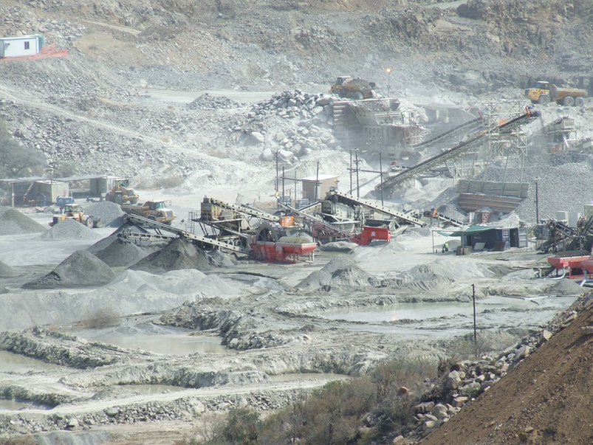
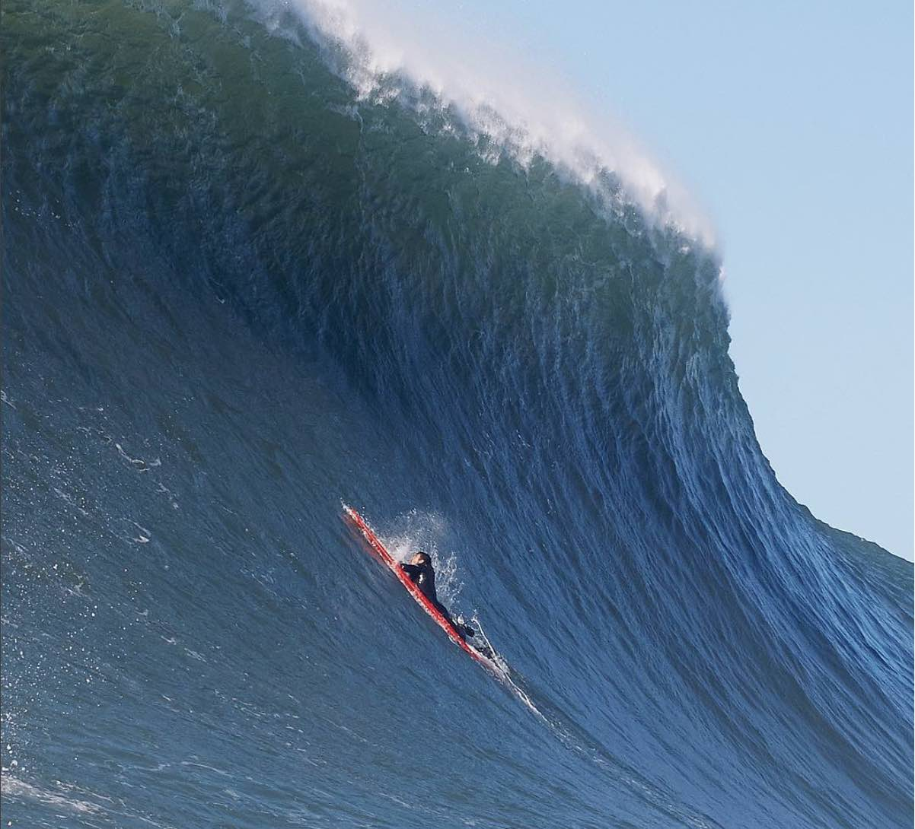
Points to be covered:
Challenges faced & lessons learnt
Introduction
Aggregates
Sampling
Interim land use
Q&A
Workshop observations
Final comments

Slide 3
Introduction:
Challenges faced & lessons learnt
The core reason for the workshop
  Learn from the challenges faced on the 1st phase of very lengthy projects along the N3 & N2, over the next 6 - 10 years.
  The lessons learnt to be ironed out so that the next contractors can better streamline the future phases of the project.
The Sanral workshop was well attended
  Suppliers, Contractors, Consulting Engineers, Sanral
  Total of 170 delegates
ASPASA representation
  AfriSam, Midmar Crusher, Blurock Quarries.

Slide 4
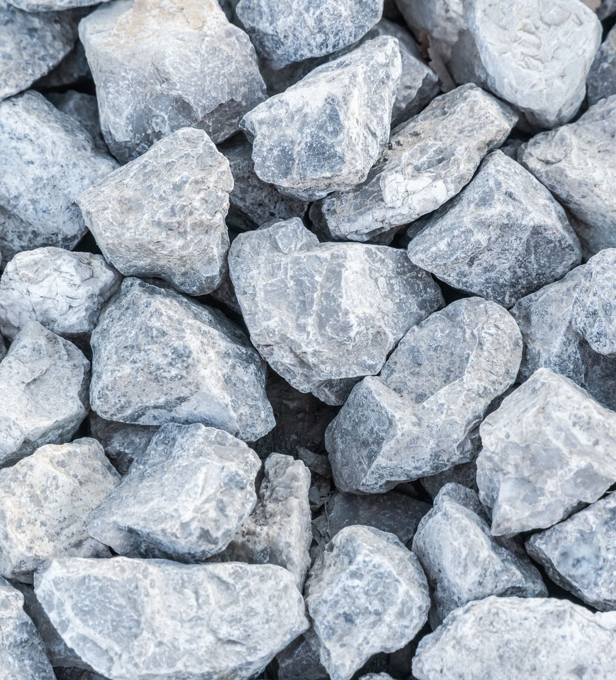
Aggregates …..1
Aggregate properties,
  90% of properties cannot be changed due to the parent rock source / geological characteristics.
Existing operations have years of results and know their resource.
Minimum standards covered and the challenges for quarries when contractors or projects use combination of old & new standards.
Quality is important but consistency is vitally important
  Ensure that the aggregate variation doesn’t cause the need for a mix design change.
Grading envelop requirements for course and fine aggregates.
Crusher Dust / sand makes up +60% of an Asphalt mix.

Slide 5
Aggregates …..2
Smectites discussed
  Within a quarry, the contents changes between benches,
  The importance of mapping one's pit to know where the better benches are especially for Surfacing Stone specifications.
  RXD testing is becoming more relevant and requested on all National road contracts.
Crushing challenges
  Any changes made in the crushing stages causes a variation to the end product
    Screen exchange (old to new),
    VSI speed increase to better fines production due to demand
    Liner changes (new liners crush differently)

Slide 6
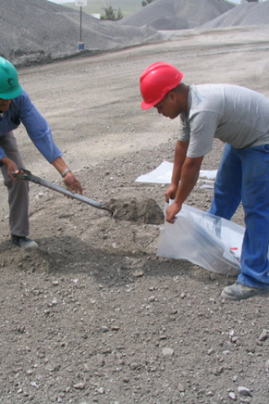
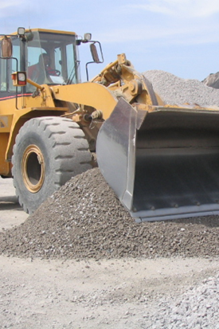
Sampling
Poor sampling is a major frustration, causing unnecessary disruptions to project production.
Sabita’s Manual 35/TMH5 states
“Incorrect sampling procedures from stockpiles is one of the most common occurrences of material disputes”

Slide 7
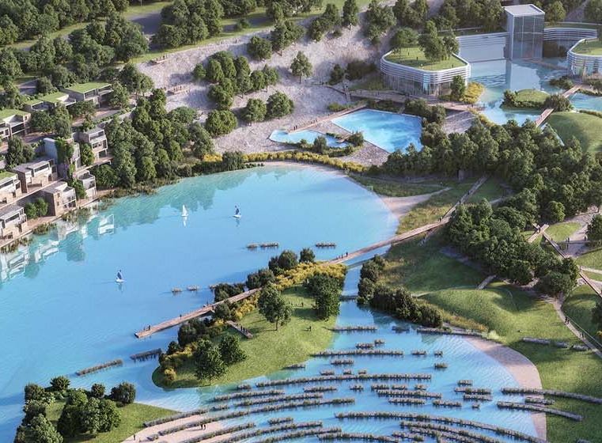
Interim land use
Every quarry is classified for interim land use
Stringent rehabilitation plans & monetary resources are in place
Used once need arises to rehabilitate the quarry.

Slide 8

Q&A ….1
Q1 Many questions asked where mainly around the supply of material and that the current operations could not keep up with demand.
Answer
  Early discussion & continued communication with industry is of utmost importance to best plan the supply.
  Volume of work issued within a short period of time with limited suppliers, remains a challenge.
Q2 The increased demand has caused a change in the material from what was originally sampled, and the obvious revisions to the original mix designs.
Answer
  Increased demand can cause changes to the original material as supplied;
  Volumes vs original specs is a dilemma.

Slide 9
Q&A ….2
Q3 How can aggregate suppliers ensure consistency of their product?
Answer 3-a
  As mentioned there will always be slight changes in the product when there are necessary changes in the plant e.g. replacement of liner changes, etc
  This needs to be communicated with the customer
  Time required to make necessary adjustments to get the end results aligned again.
Answer A3-b
  A quality control system should be in place to manage any changes
  Communication vital with all parties.

Slide 10
Q&A ….3
Q4 Changes in crusher settings
  VSI speed causes the crusher dust angularity to change which has an effect to the way the material behaves in a particular mix design.
  Can we create a test for angularity?
Answer
  Noted the statement and question but difficult to test and manage for increased volumes
  Changes required to keep up with demand.

Slide 11
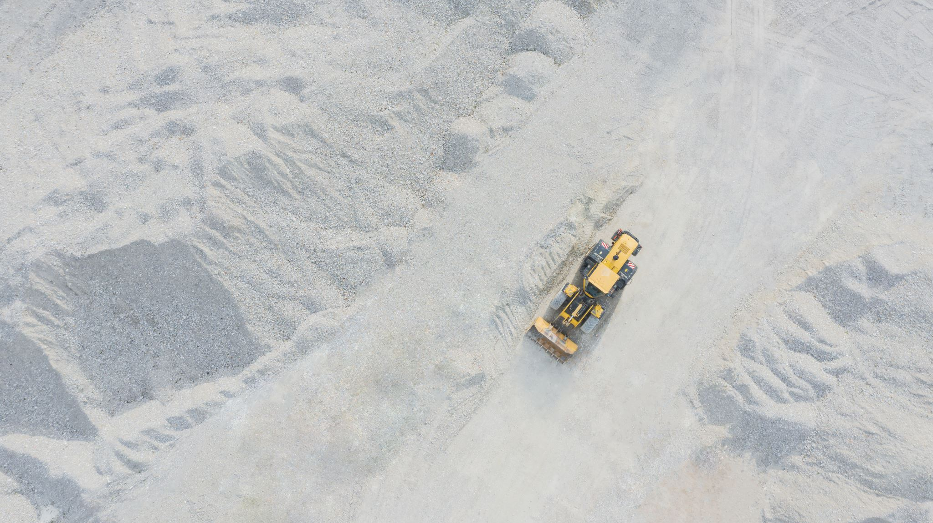
Workshop observations …1
Quarries are not the only areas of concern for these projects.
  Changes to bitumen supply causing huge challenges & long-term concerns for the contract.
Sanral quarry RCL9 proposed to supply material for contracts
  The original plan shifted drastically when RCL9 was unable to meet the necessary specification.
  All the details & reasons not covered.
  An additional individual meeting with Sanral representatives proposed to listen to the challenges & look for solutions.
Some aggregate products were discontinued during the project through legislative challenges
  Not sure of all the details but focusing around water usage license (WUL)
  Resulting in mix design changes.

Slide 12
Workshop observations …2
Any mix design change required costs in the region of R150k
More importantly, takes approx. 20 weeks for results on a redesign.
This was a major focus - limit the need for such design changes
How can the construction industry as a whole limit the changes in their materials supplied ?
  Aggregate & bituminous binder supply

Slide 13
Final comments
Sanral team very appreciative of ASPASA’s attendance
  Willingness to put themselves on the front line to look at solutions going forward.
This is a brief snapshot of the event, from Jeremy Hunter-Smith point of view
Some additional points from my perspective:
  Proposal for ILC on all N2/N3 contracts to control quality on these contracts
  Consistency in designs between contracts will assist in reducing variations in production requirements by suppliers = better consistently in product
  Open communication critical in all these issues

